Slide 1

VIRTUAL INTELLIGENCE DIRECTORATE
OMNIA VINCIT SAPIENTA
NOTIA INTEGRATED AIR DEFENSE SYSTEM
INTREP VID-OPAC-002
DISCLAIMER:
This is for multiplayer online gaming using the Digital Combat Systems simulation software published by Eagle Dynamics. The information is not in any way suitable for real world use or operations.
Version: 1.0
Published: 2025-01-05

Slide 2
INTRODUCTION
A
A
Aim:
First part of the report contains general information about IADS, while the second part of this report intends to present information on the Notian IADS, how it functions and critical target components.
Reference:
INTREP VIS B-001 Generic Ground Force Structure v1.0
Content:
Part 1: General IADS information
IADS
Command Centre
SAM Site
Early Warning Radar
Connection node
Power supply
AWACS
Air Defense Fighters
IADS Tactics
Part 2: Notian IADS
Notian IADS organization
Notian ADF sector North
Notian ADF sector South
B
B
C
C
D
D
E
E
F
F

Slide 3
PART 1: GENERAL IADS INFORMATION

Slide 4
Integrated Air Defense System (IADS)
An Integrated Air Defense System (IADS) is a wide network of surface-to-air forces that work together to defend the skies of a specific area. The system is also connected to the fighter aircraft in the A-A role either in a airborne CAP or intercept aircraft on ground alert that can be scrambled toward incoming threats.
There are several elements that are part of this network, which all will be explained more in detail in the next slides:
Air Defense Command Centre
Early Warning Radar (EWR)
SAM Site
Sector Command Centre
Power source
AWACS
Air Defense Fighters
Example:
The illustration to the right show a simple IADS. Each sector have a EWR that feeds information into a sector command centre. SAMs are off, and only turn on to fire based on the information from the EWR that they are within range. In addition, as long as the sector is connected to the entire IADS, they can also be activate based on other EWRs in IADS. AWACS is also supporting and contributing via the command center and functions as a extra EWR. Fighters on standby can also be launched to either sector based on radar information from EWR or AWACS.
SECTOR A
SECTOR B
A
A
B
B
SAM 2
SAM 5
C
C
D
D
SAM 1
SAM 3
SAM 4
SAM 6
Sector Command Centre
Sector Command Centre
E
E
F
F
EWR A
EWR B
Air Defense Command Centre
AWACS
EWR Center
Fighters
Back

Slide 5
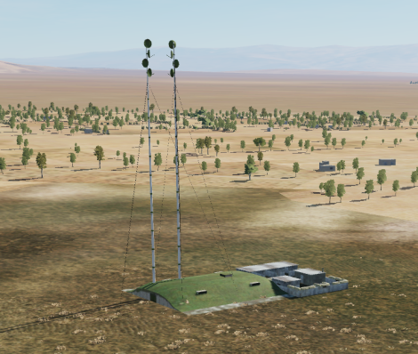
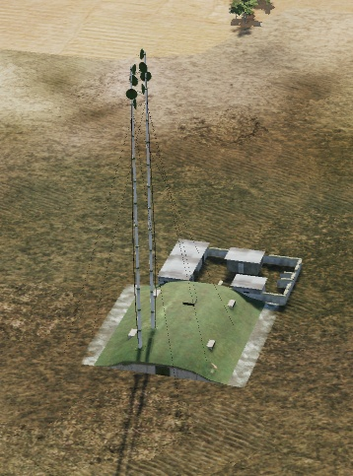
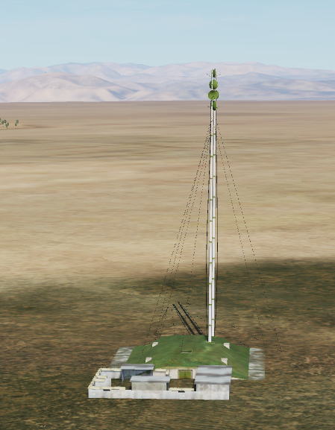
AIR DEFENSE COMMAND CENTRE (ADCC)
This is the central node of the entire IADS.
The air defense command centre coordinates all parts of the IADS and make sure to give orders and information to the relevant participants.
The air defense command centre is powered by a primary power source and a backup power source.
By attacking and destroying the power sources the air defense command centre is unable to function.
Often the air defense command centre also will have a backup command centre that takes its function if the primary command center is destroyed. The backup command center will have its own power sources to function.
The air defense command center and backup command center are fixed installations that are not moved around.
Example of a command center can be seen to the right.
A
A
B
B
C
C
D
D
E
E
F
F
Back

Slide 6
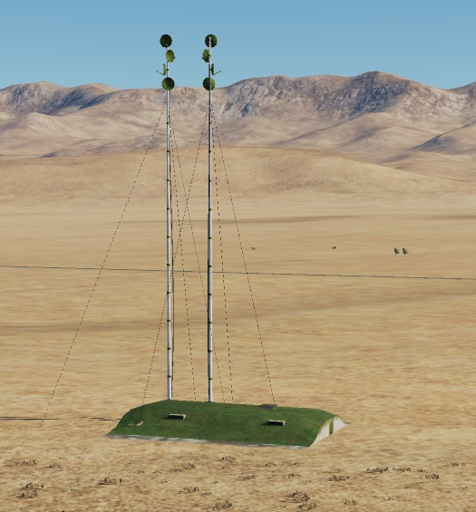
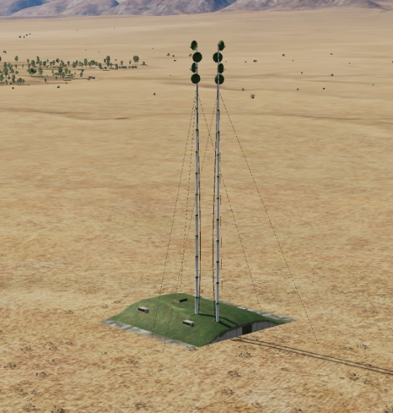
SECTOR COMMAND CENTER (SCC)
The sector command center is the centralized area where an air defense sector is controlled. All SAMs and EWRs in a region will be connected to the sector command center.
The air defense sector will also be supported by the overall IADS resources such as other EWRs, AWACS, air defense fighters flying CAP or interceptors on ground alert.
If the sector command center is destroyed, the sector will be cut off from other IADS resources, some SAMs may then be off permanently (they are not aware that the sector command center is destroyed), or they can be active all the time, making it easier to locate them SAMs in the sector for engagement with standoff precision munitions.
Example of a sector command center seen on the right.
A
A
B
B
C
C
D
D
E
E
F
F
Back

Slide 7
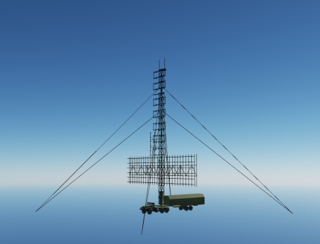
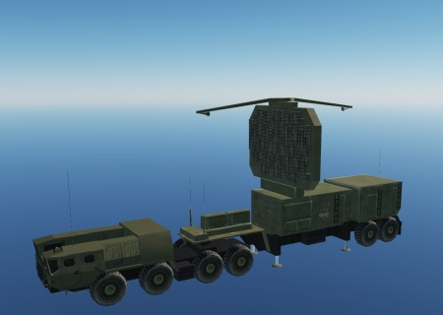
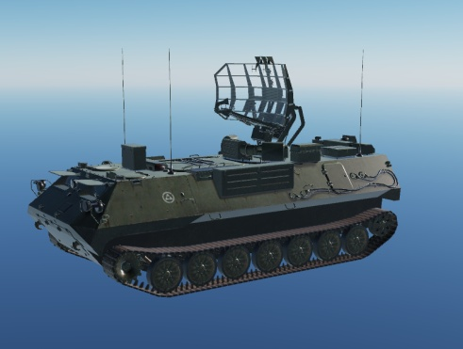
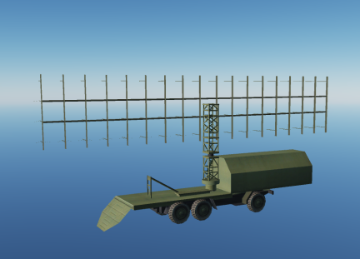
EARLY WARNING RADAR (EWR)
EWRs are critical parts of the IADS network. EWR scan the skies regularly and feed information to the sector command center or the IADS command center. This makes it possible for SAM sites to be dark (radar off), and only activating to fire a missile once they know a target is within range. This create a lethal combination as the first time a pilot may get a warning from the SAM is when it starts firing at the pilot.
EWRs may be on all the time, or be on at regular intervals to ensure good coverage.
EWRs is high value targets that is likely protected by point defense system and are placed within the umbrella of the IADS network.
EWRs are normally placed at locations which gives best possible coverage of the airspace in the sector.
By avoiding detection by EWRs it is possible to sneak in to a sector and conduct the mission without being shot at.
Large SAM sites such as the SA-10 have powerful radars that also can be used as EWR.
Examples of EWRs seen to the right.
A
A
B
B
C
C
D
D
E
E
F
F
Back

Slide 8
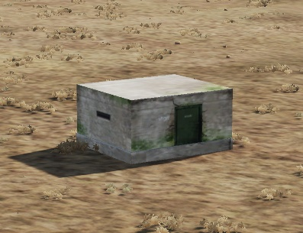
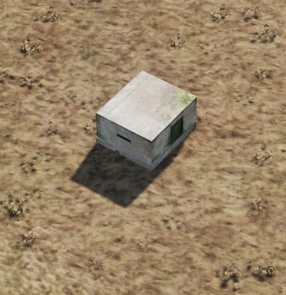
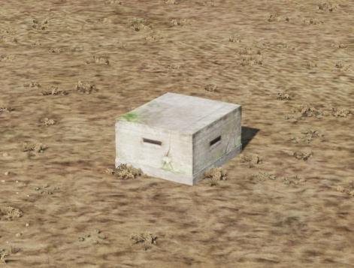
POWER SOURCE
Certain parts of the IADS network may require a external power source to function.
Many elements of the IADS, such as the smaller SAM systems have autonomous power and will not be affected by the destruction of power sources. But EWRs and IADS command center may require minimum one power source to operate. Some elements may also have a backup power source to be able to function in case the primary power source is destroyed.
Examples of primary power source seen to the right.
A
A
B
B
C
C
D
D
E
E
F
F
Back

Slide 9
SAM SITE
SAMs is the primary threat to aircraft and helicopters.
SAM units are explained in INTREP VIS B-001 Generic Ground Force Structure v1.0, pages 46-57.
IADS will normally consist of multiple systems complementing each other. The larger systems (SA-5, SA-10, SA-2, SA-11, SA-6) can be protected by point defense systems such as the Air Defense Forces Battalions/Batteries and Platoons.
Mobile SAMs in the IADS will move regularly. SAMs will stay silent (dark= avoid emitting with their radars) as long as possible to avoid being targeted and to keep the element of surprise.
IADS SAMs static vs mobile
SA-6: Mobile
SA-11: Mobile
SA-2: Semi static
SA-3: Semi static
SA-5: Semi static
SA-10: Semi static
Semi static:
Launchers are static but the SAM system can be moved if required due to shifting priorities of the IADS commander. This will likely be picked up by intelligence sources, and will take some time to complete.
Mobile:
SAMs as a part of the IADS are given a area to protect, and will stay fairly static to be able to cover this area. But the radar and the launchers will be moving around, in order not to stay in the same location for prolonged period of times (more then 24 hours). The movement can vary from a few meters to kilometers. The intention is to avoid beeing targeted by weapons that is launched at coordinates.
A
A
B
B
C
C
D
D
E
E
F
F
Back

Slide 10
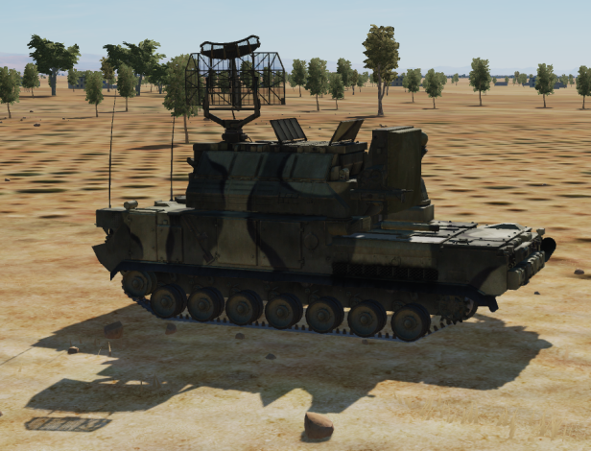
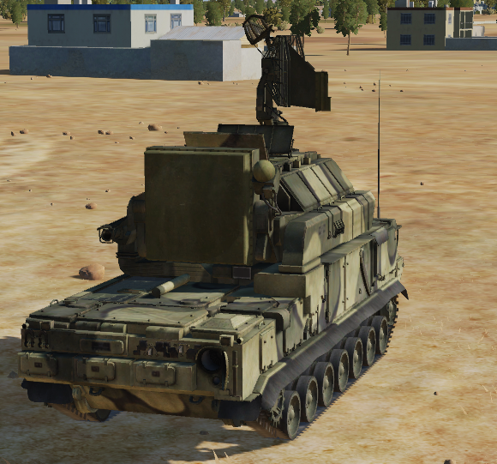
POINT DEFENSE
High Value Targets (HVT) such as EWRs, command centers or important SAMs may have a local point defense. The intention for the point defense is to be able to shoot down Anti Radiation Missiles (ARM) that are being launched at the HVT.
The only known point defense system is the SA-15.
It is assessed that if a point defense system is protecting a enemy radar, such as a EWR or SAM, the EWR or SAM may still operate even though a ARM is fired toward it. It will require multiple ARMs to flood the point defense in order to be able to shut enemy radars down if they are protected by point defense systems.
A
A
B
B
C
C
D
D
E
E
F
F
Back

Slide 11
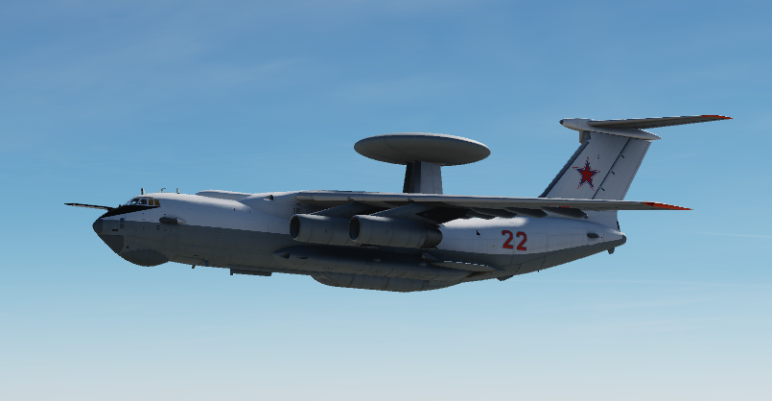
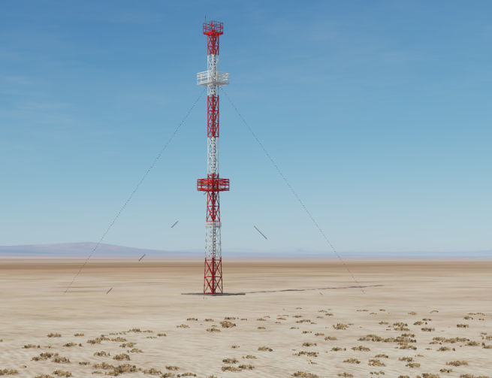
AWACS
AWACS can be a huge contributor to the IADS by providing coverage down into valleys and into areas where the EWRs are not able to detect aircrafts.
AWACS function in the IADS in a similar was as EWRs.
AWACS is limited in numbers and a very high value target.
AWACS is transmits its information into the IADS and the command center via a connection node, as shown on the picture to the right.
A
A
B
B
C
C
D
D
E
E
F
F
Back

Slide 12
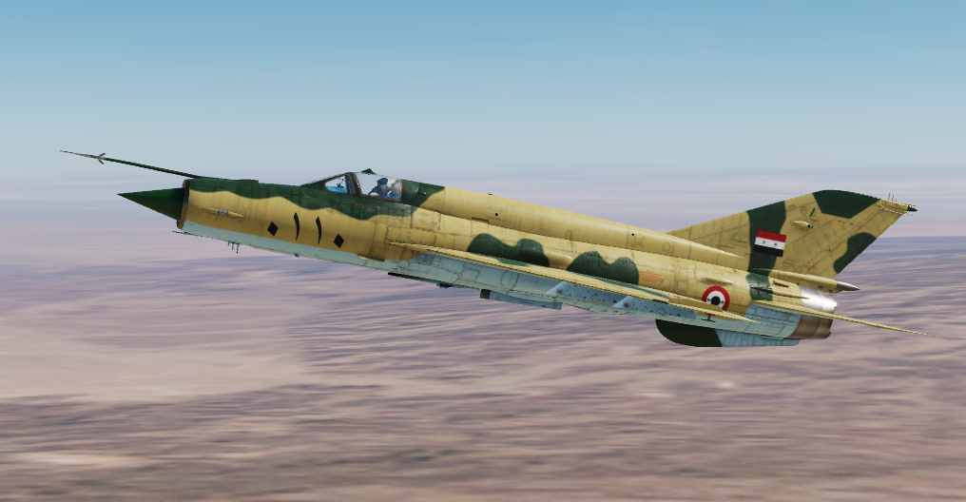
AIR DEFENSE FIGHTERS
Air Defense fighters flying either CAP mission, or a ground based alert, ready to scramble and intercept incoming fighters is a important part of any IADS.
Continuous CAP mission require a high availability of aircraft and is likely only possible for limited time or a very few areas. A more resource friendly way of supporting the IADS is to have intercept aircraft on ground alert. This way, the aircraft can be on alert and ready to scramble in case EWR or other parts of the IADS detect incoming aircraft.
Air Defense fighters can be controlled either from AWACS if a country have that, or they can be controlled by Ground Controlled Intercept (GCI), where a human controller, normally situated in the ADCC or SCC vectors the air defense fighters against incoming threat.
A
A
B
B
C
C
D
D
E
E
F
F
Back

Slide 13
IADS TACTICS
ARM defense
SAM sites and EW radars will shut down their radars if they assess that a ARM (Anti Radiation Missile) is heading for them. For this to happen, the SAM site has to detect the ARM missile with its radar.
SAMs will not shut down for each ARM launched in the air, but they will calculate if a missile is going to land close enough to their position, and if so, they will turn silent and stop feeding information to the ARM missile.
Point defense
If an ARM was launched on an emitter, other friendly radars that are close enough can detect the missile incoming and intercept it with their own weapons. For this are required more modern radars, that can pick up the radar cross section (RCS) of an ARM missiles. SA-10 and SA-15 are powerful enough to employ this tactic to shoot down ARMs. SA-10 systems are strategic systems and will not be used in a point defense role, while the SA-15 is often used in the point defense role.
A
A
B
B
C
C
D
D
E
E
F
F
Back

Slide 14


PART 2: Notian IADS

Slide 15
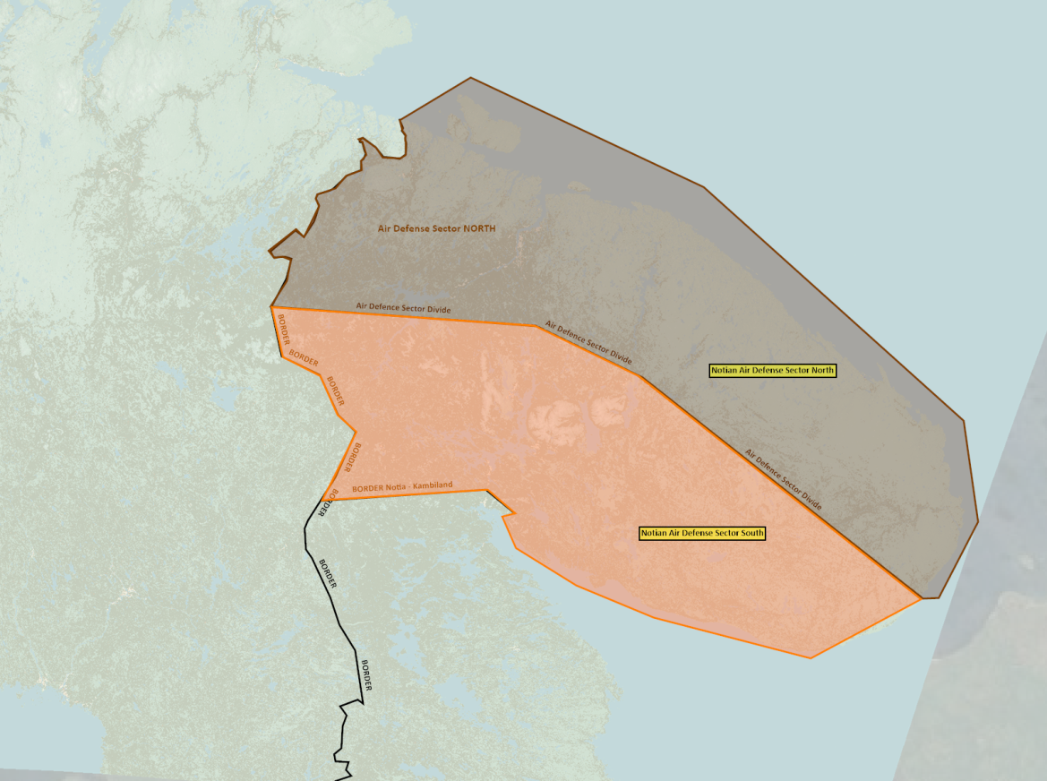
NOTIAN IADS ORGANIZATION
The Notian IADS is organized in two separate sectors: Notian Air Defense Force Sector North (SRN ADF S N), and Notian Air Defense Sector South (SRN ADF S S).
The Notian IADS is split into three elements:
First, Interceptor aircraft on QRA duty protect the entire Notian airspace.
Second, large static SAMs such as SA-5, SA-10 and SA-2 is used to protect airfields and strategic locations.
The third element is mobile SAMs such as SA-6 and SA-11 which is used to fill gaps in the coverage. These systems are mobile to avoid being targeted by long range precision guided munitions.
The air force operated GCI (Ground Controlled Intercept) system forms the top tier of the IADS, supporting fighters with GCI vectors, but also datalinking early warning information down to individual SAMs . GCI conducts control of interceptors from the sector command center. The interceptor aircraft can come from other sectors, as they will be scrambled from the Air Defense Command Center.
A
A
B
B
C
C
D
D
E
E
F
F
Back

Slide 16
NOTIAN ADF SECTOR NORTH
Notian ADF Sector NORTH is the most defended sector in Notia as it protects the capitol of Murmansk.
In addition to the units listed on the right, Murmansk is also the location where the Air Defense Command Center (ADCC) (SRNTGT108) for the entire Notian IADS network is placed
Severomorsk houses the Sector Command Center (SCC) for sector NORTH (SRNTGT109) (IVO SEVEROMORSK-1).
ADF Sector NORTH’s focus is to protect Murmansk and Severomorsk to keep the regime safe, as well as protect strategic important installations (airfields).
Additional SAM units from the Notian Army may also contribute to the defense of Murmansk and Severomorsk, but they are not a part of the IADS, and will protect on a more ad-hoc basis based on their activity, availability and alert posture.
Sector North units:
800th SA–5 Regiment
8000 EWR BN
8001 SA-5BN
8002 SA-3 BN
8003 SA-3 BN
8004 Air Defense Battery
801st SA–2 Regiment
8010 EWR BN
8011 SA-2 BN
8012 SA-3 BN
8013 SA-3 BN
8014 Air Defense Battery
811th SA–2 Regiment
8110 EWR BN
8111 SA-2 BN
8112 SA-3 BN
8113 SA-3 BN
8114 Air Defense Batter
812th SA–2 Regiment
8120 EWR BN
8121 SA-2 BN
8122 SA-3 BN
8123 SA-3 BN
8124 Air Defense Battery
Sector North units:
821st SA-6 Regiment
8210 EWR BN
8211 SA-6 BN
8212 SA-6 BN
8213 Air Defense Battery
8220nd SA-11 Battalion
8220 SA-11 Battery
8221 SA-11 Battery
829th SA-10 Regiment
8290 EWR BN
8291 SA-10 BN
8292 SA-11 BN
8293 Air Defense Battery
A
A
B
B
C
C
D
D
E
E
F
F
Back

Slide 17
NOTIAN ADF SECTOR SOUTH
The Sector Command Center (SCC) for Region SOUTH (SRNTGT110) is located IVO OLENYA Airbase.
ADF Sector SOUTH’s focus is to be the first line of defense for attacks coming from the West. In addition focus is to protect strategic important installations especially key airfields.
Additional SAM units from the Notian Army may also contribute to the air defense in sector, but they are not a part of the IADS, and will protect on a more ad-hoc basis based on their activity, availability and alert posture.
Sector South units:
831st SA–2 Regiment
8310 EWR BN
8311 SA-2 BN
8312 SA-3 BN
8313 SA-3 BN
8314A Air Defense Battery
841th SA–2 Regiment
8410 EWR BN
8411 SA-2 BN
8412 SA-3 BN
8413 SA-3 BN
8414A Air Defense Battery
851st SA-6 Regiment
8510 EWR BN
8511 SA-6 BN
8512 SA-6 BN
8513A Air Defense Battery
8520nd SA-11 Battalion
8520A SA-11 Battery
8521A SA-11 Battery
A
A
B
B
C
C
D
D
E
E
F
F
Back

Slide 18
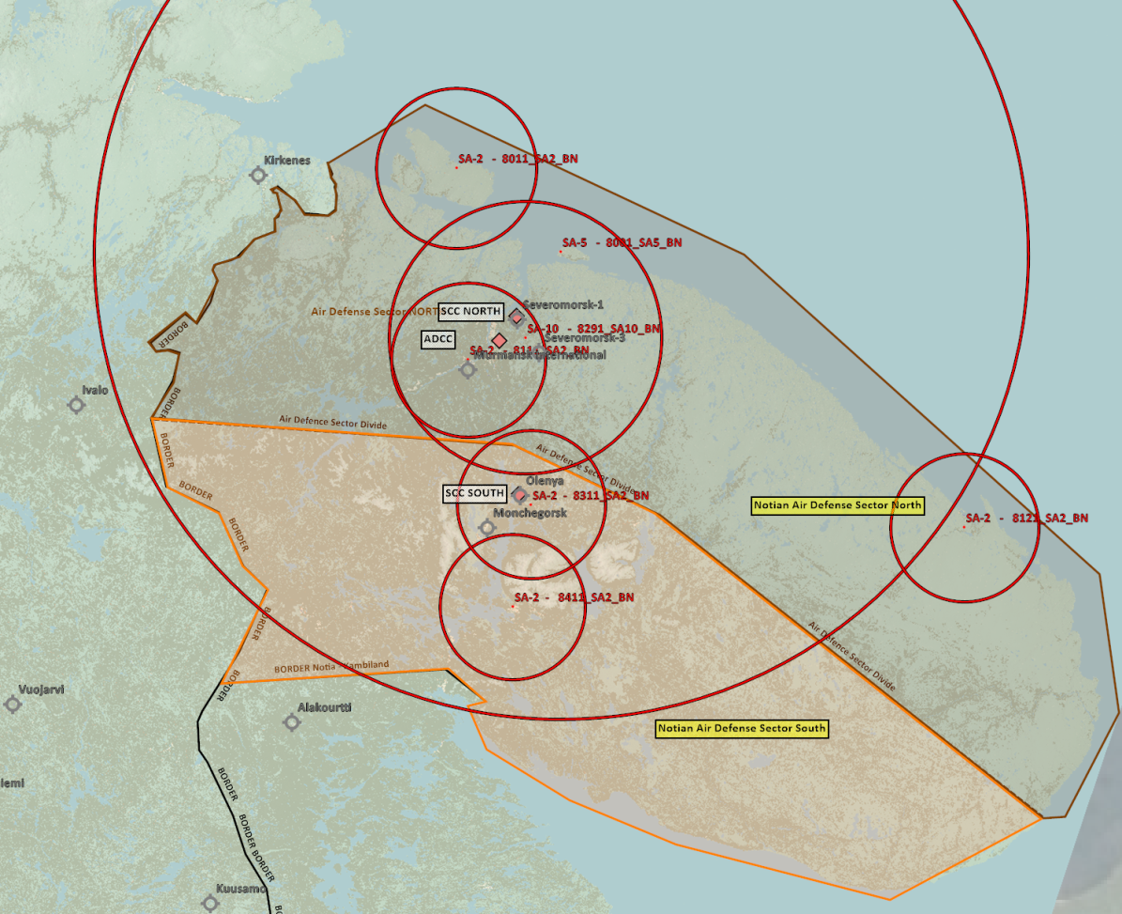
Known Notian static SAMs
Air Defense Force Sector North
SA-2 BN North
N 69 45.500 E 032 35.500
SA-2 BN South (ivo Murmansk International)
N 68 50.000 E 032 45.000
SA-2 BN East (ivo Ostrovnoy)
N 67 59.500 E 039 31.500
SA-10 BN (between Severomorsk-1 and Severomorsk-3)
N 68 56.500 E 033 32.000
SA-5 BN (North of Kola Bay)
N 69 21.500 E 034 01.000
Air Defense Force Sector South
SA-2BN North (ivo Olenya)
N 68 06.500 E 033 36.500
SA-2 BN South (ivo Apatity)
N 67 35.000 E 033 21.500
NOTE: All coordinates TLE CAT 5 coordinates and can not be used for targeting.

Slide 19
INTELLIGENCE GAPS
Provide a list of questions or gaps in intelligence, where taskings can be generated to collect information
INSERT MAP HERE
A
A
B
B
C
C
D
D
E
E
F
F
Back

